Slide 1
City of Tacoma 2021 Stormwater Management Manual
June 2021

Slide 2
Housekeeping
This Presentation is Being Recorded.
You have been muted – feel free to sing along…
Zoom Features For Today
Chat Feature
Technology Questions/Issues– Chat to Panelists
General Chatter, Encouragement, Etc. – “Cute Dog Mieke.” “Love that feature of tMap.” “City of Tacoma Employees are the best!” – Chat to Everyone
Questions about the Presentation
Use the Q&A Feature
Surveys!
These should pop up on your screen – please participate! There might be prizes…
Patience is Appreciated
Technical issues, short delays, barking dogs, crying babies, chirping birds, helicopters, etc., etc., etc. are just one of the many fun part of the presentation!

Slide 3
Agenda
Introductions
Accela Permitting Overview
NPDES Regulations
SWMM 2021 Update
Break
How to Successfully Complete a Stormwater Site Plan
Do I Even Need a Stormwater Site Plan?
Stormwater Site Plan Template
Project Site Conditions
Break!
Minimum Requirement Determination
Discussion of Minimum Requirements
Break
Construction SWPPP
Operation and Maintenance
Wrap Up

Slide 4
Welcome – Meet the Presentation Team
Mieke Hoppin - Environmental Services (ES)
Stormwater Management Manual Update Lead
Today: Co Presenter
Craig Kuntz - Planning and Development Services (PDS)
Residential Group Supervisor
Today: PDS Residential Representative
Brenda Reifsnyder – PDS
Permit Specialist Lead
Today: Special Guest Speaker
Chris Johnson – PDS
Senior Principal Engineer – Site Development Group
Today: Special Guest Speaker
Merita Trohimovich – ES
Principal Engineer – NPDES Group
Today: Presentation Facilitator

Slide 5
Survey #1 Who is Joining Us Today?

Slide 6
Permitting Overview
And now over to our special guest speaker…
Notes:
Chris and Brenda

Slide 7
Complete Submittals Are Important!!
Missing items will add at least 1 month to review time.
City of Tacoma staff are available to assist and answer questions.
Goal is for approval to happen at 1st review.
Not possible without a complete application.
Notes:
Craig

Slide 8
tMap Overview!
Notes:
Craig

Slide 9
Today’s Presentation is…
Learning!!!
Quick Overview of City of Tacoma Permits – It Was Great!
Overview of the City of Tacoma Stormwater Management Manual
How to Successfully (fingers crossed) Complete a Stormwater Site Plan – Short Form
An ability to use your imagination!
Ask Questions at any time! Remember to use Q&A Feature.
Scheduled Breaks Throughout
Jokes
Dancing

Slide 10
Today’s Presentation is Also…
A lot of information
A lot of jargon
An attempt to distill 1000 pages to something slightly more manageable.
Going to be available online as a resource.
Only one additional resource
The SWMM itself
Tip Sheets
City staff!

Slide 11
Today’s Presentation is not…
How to Determine Offsite Improvements
Electronic File Standards
Code Citations
Project Specific
Not one size fits all…
Going to Put You to Sleep (fingers crossed).
***************************************************
Additional information on some of the above topics can be found in Tip Sheets available at tacomapermits.org

Slide 12
Why?!?
Development increases stormwater because it creates surfaces for rain/snow to runoff.
Unmitigated stormwater has negative effects on receiving waterbodies and infrastructure.
Negative effects of stormwater:
Stormwater Picks Up Pollutants
Increased Flowrates Cause Erosion → More Pollutants
Pollutants → Fish Kill
https://www.youtube.com/watch?v=omUuWxP8YFU
Flooding
https://www.youtube.com/watch?v=L1Y3740YzOc

Slide 13
Why? Regulations…
The Clean Water Act prohibits anybody from discharging pollutants through a point source without an NPDES permit.
The City of Tacoma has a Phase I Municipal Stormwater Permit that allows the City to discharge stormwater to receiving waterbodies.
The Permit is issued by the Washington State Department of Ecology
The Permit requires a “program to prevent and control the impacts of runoff from new development, redevelopment, and construction activities.
The City has elected to provide a Stormwater Management Manual equivalent to the Washington State Department of Ecology’s July 2019 Stormwater Management Manual for Western Washington.
The SWMM helps ensure infrastructure that is safe, effective, efficient, economical, and sustainable.
The Stormwater Management Manual is codified in Tacoma Municipal Code 12.08D – Stormwater Management

Slide 14
How – Stormwater Management Manual
The City of Tacoma Stormwater Management Manual (SWMM) Relies on complying with Minimum Requirements and Additional Protective Measures to mitigate the negative effects of stormwater and ensure receiving waterbodies and the conveyance system are protected.

Slide 15
SWMM – Minimum Requirements (MRs)
*MR #1 – Preparation of Stormwater Site Plans
MR #2 – Construction Stormwater Pollution Prevention
MR #3 – Source Control
MR #4 – Preserving Drainage Patterns and Outfalls
MR #5 – Onsite Stormwater Management
MR #6 – Stormwater Treatment
MR #7 – Flow Control
MR #8 – Wetlands Protection
MR #9 – Operation and Maintenance
Additional Protective Measure – Infrastructure Protection
Notes:
The SWMM utilizes Minimum Requirements to ensure compliance with the Phase I Permit. The MRs are paperwork items as well as Best Management Practices (in the ground) to mitigate stormwater.

Slide 16
Why? The Future Depends on You!
Many people interact with a stormwater site plan and plan set once it has been approved:
Property Owners
Can a property owner find the facilities and assets they need to maintain years from now?
Contractors
Can a contractor understand what they are supposed to build?
Inspectors
Is it easy for an inspector to know all the components to inspect?
City Asset Management Staff
Mapping, Database Management
Business Inspection Staff
1, 5, 10, 20, 50 years from now will a new employee be able to figure out what is on the property for required inspection?
Facility Inspection Staff
1, 5, 10, 20, 50 years from now will an employee be able to figure out what facilities are on a property and how they function.
Operation and Maintenance Staff
Can crews figure out what the facility is and how to inspect and maintain the facility (is it even owned by the jurisdiction?)
Complaints
10 years from now when there is a drainage complaint can City staff easily help a property owner navigate the assets on their site?
Notes:
Why do we need to have good plan sets?

Slide 17
Where are we?
October 1995 Manual
Developed for 1995 NPDES Permit (Equivalent to Ecology’s 1992 Manual)
January 2003 Manual
Developed for extension of 1995 NPDES Permit (Equivalent to Ecology’s 2001 Manual)
September 2008 Manual
Developed for 2007-2012 NPDES Permit (Equivalent to Ecology’s 2005)
February 1, 2012 Manual
Developed in response to local community concerns and questions (developers, engineers, City staff).
January 2016 Manual
Developed for 2013-2018 NPDES Permit
July 2016 Manual – Current Version
Errata to January 2016 Version
July 2021 Manual
Public Comment Period - July 2020
Deemed Equivalent to Ecology 2019 SWMMWW – Feb. 2021
SEPA Process – March 2021
Adopted by Council – May 2021
Trainings!!
Must start using July 1, 2021

Slide 18
2021 SWMM – Update Types
Permit Compliance
Appendix 10
Changes to Meet Ecology Intent
Update for Clarity
New Layout!
Mistakes
Seems impossible but it’s true.
No Longer Applicable

Slide 19
Permit Compliance Updates
Continuous Simulation Modeling
Replaced Hard Surface Redevelopment Thresholds
Equivalent Areas
Minimum Requirement #2
Minimum Requirement #5
Minimum Requirement #7
Concrete Washout BMP
Source Control BMPs
Wetlands Guidance
Notes:
The underlined ones affect MR#1-5 projects.

Slide 20
Permit Compliance Updates
Minimum Requirement #5
Updates to ensure BMP L613: Post Construction Soil Quality and Depth is required when utilizing the LID Performance Standard
Updated whole section to meet Ecology’s intent creating 3 Lists for List Approach – similar to Ecology.
Discharges to Flow Control Exempt Waterbodies (includes salt waterbodies) now have a required order of preference for choosing BMPs (previously you could pick any from list as first choice). Example Below for Roofs:
Downspout Full Infiltration
Downspout Dispersion
Perforated Stub-Outs
Notes:
The existing SWMM does not have a required order of preference when discharging to flow control exempt waterbodies, the new SWMM will to be in line with Ecology’s intent.

Slide 21
Permit Compliance Updates
Concrete Washout BMP
Update to clarify that auxiliary concrete truck components and small concrete handling equipment may be washed into formed areas awaiting pour while concrete truck drums must be washed offsite or into a concrete washout area.

Slide 22
Clarity and Grammar
Changes made throughout manual to clarify language.
Move sections/chapters/volumes for ease of use.
Changes made to update website links, fix typos, shorten run-on sentences, etc.
Based on feedback from over the years from internal/external customers – thanks!!
Notes:
Includes making sure the information you need is all in a section of referenced appropriately.
Language changes for consistency throughout.
Language changes for industry standard and education and outreach purposes.

Slide 23
New SWMM Layout
Preface
This includes a short description of the watersheds, applicability, relationship to Permit.
Volume 1 – Minimum Requirement and Additional Protective Measures
How to determine MRs, and what the MRs are.
Volume 2 – Documentation
Description of Documentation Needed to Comply with SWMM – SSP, SWPPP, Drawings
Similar to Appendix in 2016 SWMM – Volume 1
Volume 3 – Construction Stormwater Pollution Prevention BMPs
Design criteria for BMPs for temporary erosion and sediment control during construction.
Similar to 2016 SWMM - Volume 2.
Volume 4 – Best Management Practices Library
Design criteria for all permanent stormwater BMPs.
Similar to 2016 SWMM – Volumes 3, 5, 6
Volume 5 – Stormwater Conveyance Design
Information on how to design conveyance system, approved materials, etc.
Similar to 2016 SWMM - Volume 3.
Volume 6 – Source Control
Information about long-term BMPs required on sites for source control.
Similar to 2016 – SWMM – Volume 4
Notes:
The idea behind the new layout is to make the manual more user friendly. Volumes are in general meant to mimic Minimum Requirements – so for example Volume 3 corresponds to MR#3 and contains information within that Volume to help understand what is needed to mitigate appropriately for that MR.

Slide 24
City Updates
Only 9 Minimum Requirements
One Additional Protective Measure – Infrastructure Protection (Was MR#10)
Updated so City of Tacoma makes determination of mitigation needs to protect our system.
New BMPs
Portable Sediment Tank
Discharge to Wastewater System
Rooftop Dog Run
Updates throughout that clarify language.
Gender neutrality updates to language throughout.
Changes to use similar terms throughout.
Notes:
Infrastructure Protection was altered to remove the qualitative downstream analysis. The City learned that issues found in the field are pretty common throughout the City – ponding in low spots, leaf fall, etc.
The quantitative analysis thresholds remain the same – projects will still be required to complete a quantitative analysis but the mitigation needs will be project specific based upon the City knowledge of the downstream system.
Onsite detention, upsizing the downstream system, possibly payment into a program, or maybe no mitigation are all possible. The goal is to holisitically work to upgrade and improve the stormwater system in a way that makes sense instead of small piece-meal fixes that might not make the most sense in the overall scheme of things.

Slide 25
Tacoma Municipal Code Update
TMC 12.08 will be divided into 4 sections
12.08A – General Administration
12.08B – Use of Sanitary Sewer
12.08C – Industrial Wastewater Pretreatment Program
12.08D – Stormwater Management
New code will go into effect July 1, 2021
A few minor revisions to 12.08D for compliance with the 2019 NPDES SW Permit
No substantive changes / Updates for clarity
Officially changes name from “Surface Water” to “Stormwater”
Use 12.08A and 12.08D to understand stormwater code

Slide 26
Questions? Please Use Q&A…and a joke!
Q. How do you fix a broken tomato?
A. With tomato paste!

Slide 27
Break!!!
Notes:
Play - Your Song – Billy Paul

Slide 28
How to Successfully Complete a Stormwater Site Plan
Example Project!
The story, names, characters and circumstances portrayed in this example are fictitious. Any similarities to actual projects are coincidental. No animals were harmed in the making of this presentation.
Notes:
The following slides will be accompanied with a fictional example.

Slide 29
Step 1: Do I Even Need a Stormwater Site Plan?
To make this decision, Answer the Following Questions:
Is the Project Exempt
What is the Project?
Where is the Project?
Notes:
Do I even need to submit anything for SWMM compliance?

Slide 30
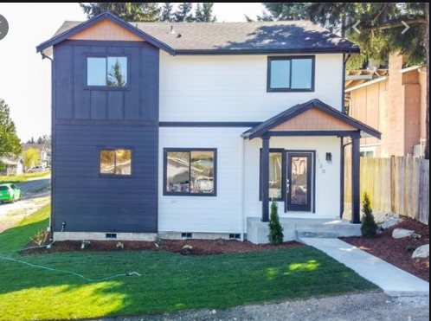
Today’s Project - Single Family Home
Existing Conditions:
Total Project Area: 6,648 ft²
Total Onsite Lot Area: 6,000 ft²
Grassy Lot: 6,000 ft²
Total Offsite Area: 648 ft²
Grassy/Gravelly Area: 598 ft²
Front Road: 30 ft²
Back Alley: 20 ft²
Proposed Condition:
Onsite
New Single Family Home with Detached Garage
New House Roof Area: 1,200 ft²
Patio: 150 ft²
New Detached Garage Roof Area: 400 ft²
New Driveway: 180 ft²
Walkways: 140 ft²
Landscaped Areas: 3930 ft²
Offsite Improvements:
Sidewalk along Frontage: 184 ft²
Side Sewer Utility Cut: 30 ft²
Planter Strip and Back of Walk = Landscaped: 414 ft²
Driveway Approach: 20 ft²
Example Project!

Slide 31
Is the Project Exempt?
Is the project solely one of the following:
Forest Practices
Commercial Agriculture
Oil and Gas Field Activities and Operations
Pavement Maintenance:
Pothole and square cut patching
Overlaying existing asphalt or concrete pavement with asphalt or concrete without expanding the area of coverage (overlaying permeable or pervious pavements with traditional (non-permeable) asphalt or pavement is not considered pavement maintenance).
Shoulder grading
Reshaping/regrading stormwater systems
Crack sealing
Resurfacing with in-kind material without expanding the road prism
Pavement preservation activities that do not expand the road prism
Vegetation maintenance
Catch basin and pipe maintenance
Underground Utility Projects that replace the ground surface with in-kind material or material with similar runoff characteristics
Minor Land Disturbing Activities
Subsurface exploratory excavations for completing Soils Reports
Removal of hazardous trees
Removal of trees or other vegetation which cause sight distance obstructions at intersections (sight distance obstructions are determined by the City of Tacoma Traffic Engineering Section).
Emergencies
Emergency projects which, if not performed immediately would substantially endanger life or property, are exempt only to the extent necessary to meet the emergency.

Slide 32
Things that Seem Like Pavement Maintenance Exemptions But Are Not
These practices are not exempt but they really sound like pavement maintenance:
The following is not exempt and is considered replaced hard surfaces:
Removing and replacing an asphalt or concrete pavement to top of base course or lower or repairing the pavement base.
The following are not exempt, they are considered new hard surfaces:
Extending the pavement edge without increasing the size of the road prism
Paving graveled shoulders
Resurfacing, by upgrading, from dirt to gravel, bituminous surface treatment, asphalt or concrete;
Resurfacing by upgrading from gravel to bituminous surface treatment, asphalt or concrete;
Resurfacing by upgrading from a bituminous surface treatment to asphalt or concrete.

Slide 33
Survey #2 – Is Our Project Exempt?
Project Reminder:
Existing Conditions:
Total Project Area: 6,648 ft²
Total Onsite Lot Area: 6,000 ft²
Grassy Lot: 6,000 ft²
Total Offsite Area: 648 ft²
Grassy/Gravelly Area: 598 ft²
Front Road: 30 ft²
Back Alley: 20 ft²
Proposed Condition:
Onsite
New Single Family Home with Detached Garage
New House Roof Area: 1,200 ft²
Patio: 150 ft²
New Detached Garage Roof Area: 400 ft²
New Driveway: 180 ft²
Walkways: 140 ft²
Landscaped Areas: 3930 ft²
Offsite Improvements:
Sidewalk along Frontage: 184 ft²
Side Sewer Utility Cut: 30 ft²
Planter Strip and Back of Walk = Landscaped: 414 ft²
Driveway Approach: 20 ft²
Example Project!

Slide 34
Survey #2 - Answer
No! The project is not exempt from needing to comply with the SWMM.
It was not a project to solely do one of the exempt activities.
Example Project!

Slide 35
Do we need a Stormwater Site Plan – What is the Project?
Know your definitions – review them for every project!!!
Both onsite (on private parcels) and offsite (work in ROW) development are included together when determining compliance for all MRs.

Slide 36
Major Definitions You Will Need to Know
Project
Common Plan of Development
Project Site
Hard Surface
Land Disturbing Activity

Slide 37
Important Definition
Project: Any proposed action to alter or develop a project site. The proposed action of a permit application or an approval which requires stormwater mitigation review.
Projects can be defined by:
Common Plans of Development
Land Use Actions
New development or redevelopment on contiguous or non-contiguous parcels that are permitted under a single permit number or that are part of a subdivision regardless of ownership.
Other City departmental conditions and review (e.g. offsite improvements are imposed on multiple parcels)
Land use actions that would affect if a proposed development is a project include, without limitation, plats, short plats, site specific rezones, wetland development permits, conditional use permits, shoreline development permits, and SEPA, if the intent of those land use actions is to develop the affected parcel, parcels or right of way.
All other land use permits may create a project depending upon the project scope proposed in the land use action.
ES/Site Development Group reserves the right to make the final determination of what is considered to be the project.
Notes:
Minimum Requirements apply to a project. Project Site and Site are for determining MRs for Redevelopment Projects.

Slide 38
Important Definition
Common Plan of Development: A project site where multiple separate and distinct construction activities may be taking place at different times on different schedules and/or by different contractors, but still under a single plan.
Notes:
Is this part of a short plat or plat? Use other Template. As a developer are you developing a number of things in close proximity to this?

Slide 39
Common Plan of Development Examples
Phased projects and projects with multiple filings or lots, even if the separate phases or filings/lots will be constructed under separate contract or by separate owners (e.g., a plat or short plat where lots are sold to separate builders).
A development plan that may be phased over multiple years, but is still under a consistent plan for long-term development.
New development or redevelopment in contiguous areas that may be unrelated but still under the same contract, such as construction of a building extension and a new parking lot at the same facility.
New development or redevelopment on contiguous lots that are not associated with a land use action, that are owned by a single entity, even if construction on the lots will not occur at the same time.
New development or redevelopment on non-contiguous lots that are located on the same City block and discharge to the same threshold discharge area, owned by a single entity, even if construction will not occur at the same time.
New development or redevelopment on linear projects such as roads, pipelines, or utilities.
If the project is part of a common plan of development or sale, the disturbed area of the entire plan must be used to determine permit requirements.

Slide 40
Three empty lots purchased with intent to develop into three separate single family homes.
These would all be considered one project – the hard surface area would be added together to determine which Minimum Requirements apply.

Slide 41
Important Definition
Project Site: That portion of a property, properties, or right of way subject to land disturbing activities, new hard surfaces, or replaced hard surfaces.
On-site and associated off-site improvements shall be added together when determining if a project site exceeds a threshold. Environmental Services/Site Development Group reserves the right to make the final determination of the project site.

Slide 42
Project Site Example
White Outline is the parcel – the onsite portion of work.
The Green area is the entire project site – including both work on the parcel of land and in the Right of Way.

Slide 43
Important Definitions
Hard Surface – An impervious surface, a permeable pavement, or a vegetated roof.
New Hard Surface: A newly created impervious surface, permeable pavement, or vegetated roof.
Replaced Hard Surface: For structures: the removal and replacement of hard surfaces down to or including the foundation. For other hard surfaces, the removal down to bare soil or top of base course layer and replacement.
Notes:
Not as big a deal for smaller projects whether or not these are appropriately categorized but you will see these words when looking to figure out your thresholds.

Slide 44
Important Definition
Land disturbing activity: Any activity that results in a change in the existing soil cover (both vegetative and non-vegetative) and/or existing soil topography.
Land disturbing activities include, but are not limited to clearing, grading, filling, and excavation.
Compaction that is associated with stabilization of structures and road construction shall be considered a land disturbing activity.
Vegetation maintenance practices, including landscape maintenance and gardening, are not considered land-disturbing activity if conducted according to established standards and procedures.
Stormwater BMP/facility maintenance is not considered land disturbing activity if conducted according to established standards and procedures.

Slide 45
Now I know some definitions – Do I Need an SSP?
Does the Project Result in 2,000 Square Feet or Greater of New Plus Replaced Hard Surface Area?
Does the Project have land disturbing activity of 7,000 square feet or greater?
If You Answer Yes to Either of These Questions A Stormwater Site Plan is Required.

Slide 46
Survey #3 – Does our project need an SSP?
Project Reminder:
Existing Conditions:
Total Project Area: 6,648 ft²
Total Onsite Lot Area: 6,000 ft²
Grassy Lot: 6,000 ft²
Total Offsite Area: 648 ft²
Grassy/Gravelly Area: 598 ft²
Front Road: 30 ft²
Back Alley: 20 ft²
Proposed Condition:
Onsite
New Single Family Home with Detached Garage
New House Roof Area: 1,200 ft²
Patio: 150 ft²
New Detached Garage Roof Area: 400 ft²
New Driveway: 180 ft²
Walkways: 140 ft²
Landscaped Areas: 3930 ft²
Offsite Improvements:
Sidewalk along Frontage: 184 ft²
Side Sewer Utility Cut: 30 ft²
Planter Strip and Back of Walk = Landscaped: 414 ft²
Driveway Approach: 20 ft²
Example Project!

Slide 47
Survey #3 – Yes and Why
Example Project!
New Hard Surfaces: New House, New Garage, Patio, Driveways, Walkways, Sidewalk = (1,200+150+400+180+140+184) = 2,274 ft²
Replaced Hard Surfaces: Utility Cuts, Driveway Approach = 30+20= 50 ft²
Total New+Replaced Hard Surface = 2,304 ft² which is greater than 2,000 ft²
Existing Conditions:
Total Project Area: 6,648 ft²
Total Onsite Lot Area: 6,000 ft²
Grassy Lot: 6,000 ft²
Total Offsite Area: 648 ft²
Grassy/Gravelly Area: 598 ft²
Front Road: 30 ft²
Back Alley: 20 ft²
Proposed Condition:
Onsite
New Single Family Home with Detached Garage
New House Roof Area: 1,200 ft²
Patio: 150 ft²
New Detached Garage Roof Area: 400 ft²
New Driveway: 180 ft²
Walkways: 140 ft²
Landscaped Areas: 3930 ft²
Offsite Improvements:
Sidewalk along Frontage: 184 ft²
Side Sewer Utility Cut: 30 ft²
Planter Strip and Back of Walk = Landscaped: 414 ft²
Driveway Approach: 20 ft²
Notes:
If the answer was no – there is still a review to ensure no issues with downstream properties.

Slide 48
SSP Template!!
Available at www.cityoftacoma.org/stormwatermanual_templates
Follows SSP requirements contained in Volume 2 of the SWMM.
Why use the template?
Consistent, quicker review
Has (probably) a space for everything you might need to submit.
Please provide feedback – email mhoppin@cityoftacoma.org about likes/dislikes, etc.

Slide 49
SSP/SWPPP Components
Title Page
General Project Information
Project Overview
Existing Project Site Conditions
Proposed Project Site Conditions
Minimum Requirement Determination
Discussion of Minimum Requirements
Conveyance System Design
Construction Stormwater Pollution Prevention Plan Report
Soils Report
Operation and Maintenance Manual

Slide 50
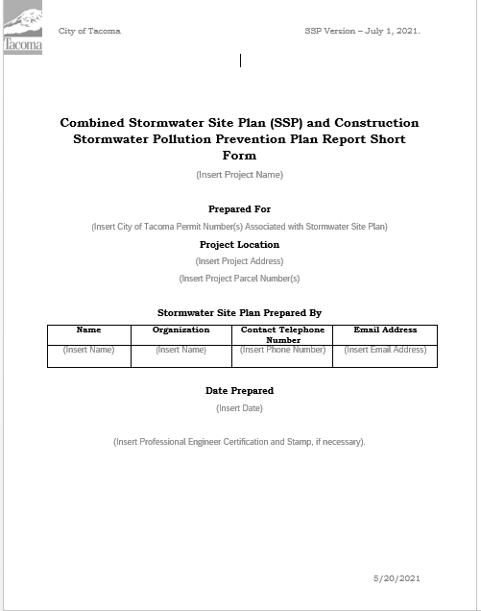
Title Page
Project Name: Give your Project a Name. Can be anything that defines the project.
City of Tacoma Permit Number (s) Associated with Project: The SDEV and/or WO associated with project.
Project Address: Current Address(es) where development will occur. If road only provide approximate location (ex. North 7th Between Cedar and Apple Street).
Parcel Number(s): ^{(map example)}
Stormwater Site Plan Prepared By: Whoever actually prepared document. This is the person we will call/email with questions – main SSP contact.
Date Prepared: For Version Control
P.E. Stamp and Certification: If SSP requires engineering calculations it must be stamped. Typically not required for smaller projects.
Notes:
Show the Example Filled Out.

Slide 51
General How To

Slide 52
Project Information
Property Owner – Who Will Own the Parcel of Land.
Applicant – Sometimes not the owner, could be consultant or engineer
Associated City of Tacoma Permits
Other Federal, State, Local Associated Permit Types – environmental related permits: https://ecology.wa.gov/Regulations-Permits/Permits-certifications/Overview-of-permitting and https://www.oria.wa.gov/site/alias__oria/permitting_our_permitting_services/347/our_permitting_services.aspx . Think Industrial Stormwater General Permit, Construction Stormwater General Permit, etc.
Vesting: Pull Down Menu

Slide 53
Vesting
2021 SWMM applies to all complete applications submitted on or after July 1, 2021
Complete application includes all plans and relevant documents necessary for the project such as:
Site Plan
SSP – including soils report
CSWPPP
O&M Manual
Landscape Plans
Predevelopment Applications (PREs) do not vest a project
Land Use actions do not necessarily vest a project
A Plat or Short Plat vests a project to a SWMM edition only when the application included all relevant documents necessary for the project (see above)

Slide 54
Project Overview
Brief description of what the project is as a whole. There is no max but 2-5 sentences should suffice.
Why?: Helpful for general overview. Helpful when SSP is used many years from now to see what SSP contains (if there are many associated with the site)
Do not include square footage values or any specifics that might be present in other parts of the SSP. Common Mistake: values used to determine Minimum Requirements are located throughout the SSP and are different in the various sections.

Slide 55
Our Project

Slide 56
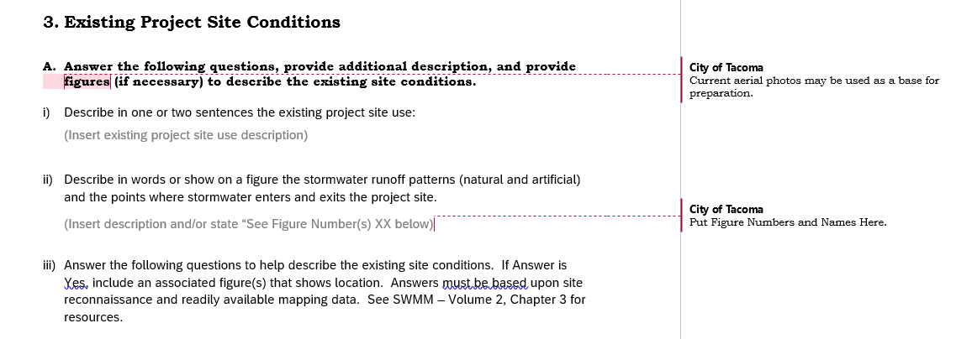
Existing Project Site Conditions

Slide 57
Existing Project Site Conditions
Questions | Answer
Are groundwater protection areas located on the project site or within 500 feet of the project site? | ☐Yes ☐No ☐Unknown
Are wetlands and/or their buffers located on the project site or within 500 feet of the project site? | ☐Yes ☐No ☐Unknown
Are steep slopes located on the project site or within 500 feet of the project site? | ☐Yes ☐No ☐Unknown
Are floodplains located on the project site or within 500 feet of the project site? | ☐Yes ☐No ☐Unknown
Are streams located on the project site or within 500 feet of the project site? | ☐Yes ☐No ☐Unknown
Are creeks located on the project site or within 500 feet of the project site? | ☐Yes ☐No ☐Unknown
Are ravines located on the project site or within 500 feet of the project site? | ☐Yes ☐No ☐Unknown

Slide 58
Existing Project Site Conditions
Are springs located on the project site or within 500 feet of the project site? | ☐Yes ☐No ☐Unknown
Are any other sensitive areas or critical areas located on the project site or within 500 feet of the project site? | ☐Yes ☐No ☐Unknown
Are any structures located on the project site? | ☐Yes ☐No ☐Unknown
Are any fuel tanks or other storage tanks (above or below-ground) located on the project site? | ☐Yes ☐No ☐Unknown
Are any groundwater wells located on the project site or within 100 feet of the project site? | ☐Yes ☐No ☐Unknown
Are any septic systems located on the project site or within 100 feet of the project site? | ☐Yes ☐No ☐Unknown
Are any Superfund sites located on the project site or within 100 feet of the project site? | ☐Yes ☐No ☐Unknown
Are any Flood Hazard Areas located on the project site or within 100 feet of the project site? | ☐Yes ☐No ☐Unknown
Is the project located in the South Tacoma Groundwater Protection District? | ☐Yes ☐No ☐Unknown
Are any public or private easements located on the project site? | ☐Yes ☐No ☐Unknown

Slide 59
How to Answer Existing Project Site Conditions Questions
Use tMap. Most questions can be answered by layers that can be added to the map.
Print feature is great!
Snipping tool can be your friend!
tMap has helpful handouts and videos for use.
Working on a Tip Sheet/Guidance Document that shows exactly what layers to add.
If an Answer of Yes is provided, include screen shot of tMap that show layers in legend that appear on map.

Slide 60
Map Example – Using tMap
www.tacomapermits.org
Explore Maps
tacomaMAP (tMap)
Finding your property.
Adding Data

Slide 61
Existing Project Conditions – Why?
Required for final site design.
Construction is limited to what can be done on a site.
Determine what type of permits might be required.
Ex. Decommission underground storage tank or septic system
Demo Permits
Land Use Permits (proximity to sensitive areas)
City uses this to help guide applicants to appropriate code sections and appropriate other agencies, if needed.

Slide 62
Existing Project Site Conditions Map
Provide a current aerial of the project site to show existing site conditions. Aerial images must show the extent of the existing hard surface areas, vegetation areas, pasture areas, and lawn/landscaped areas. Include a scale.
If available aerials do not match existing site conditions an existing site conditions map must be produced showing location of existing hard surfaces, vegetation areas, pasture areas, and lawn/landscaped areas.
Use tMap!

Slide 63
Downstream Flowpath Map
Provide a map showing the downstream flowpath from the project site to the Puget Sound – including all receiving waterbodies along the flowpath. Assume that stormwater does not infiltrate along the flowpath and will ultimately reach the Puget Sound..
Why?
Needed to determine how Minimum Requirements Apply to a Project.
Ensure the most sensitive waterbody along path is protected.
How?
Use tMap ^{(map example)}

Slide 64
Example Project!

Slide 65
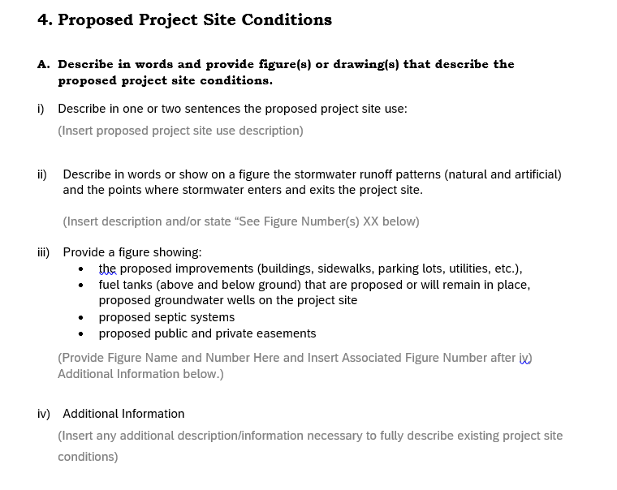
Proposed Project Site Conditions - Description

Slide 66
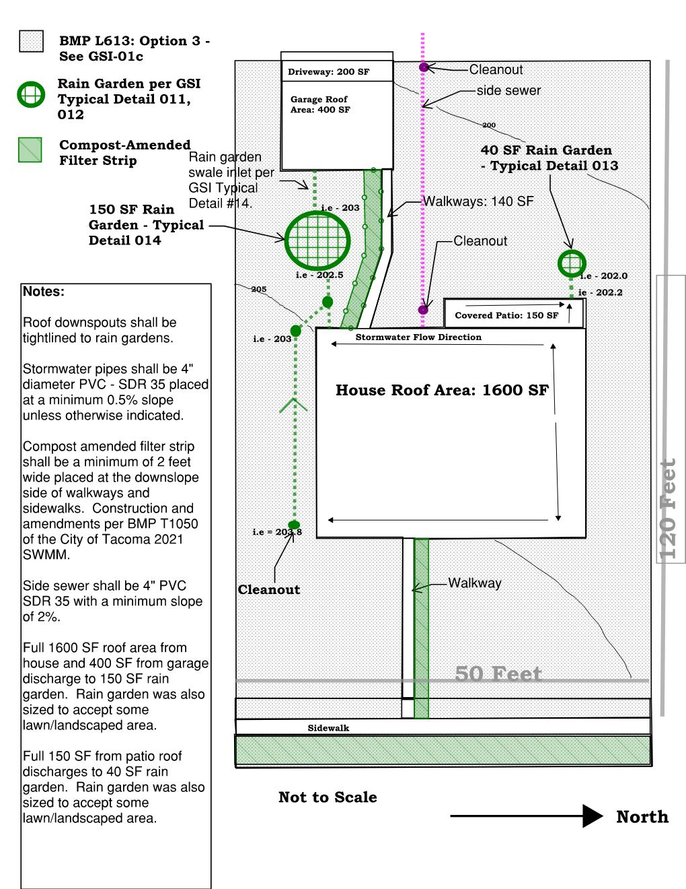
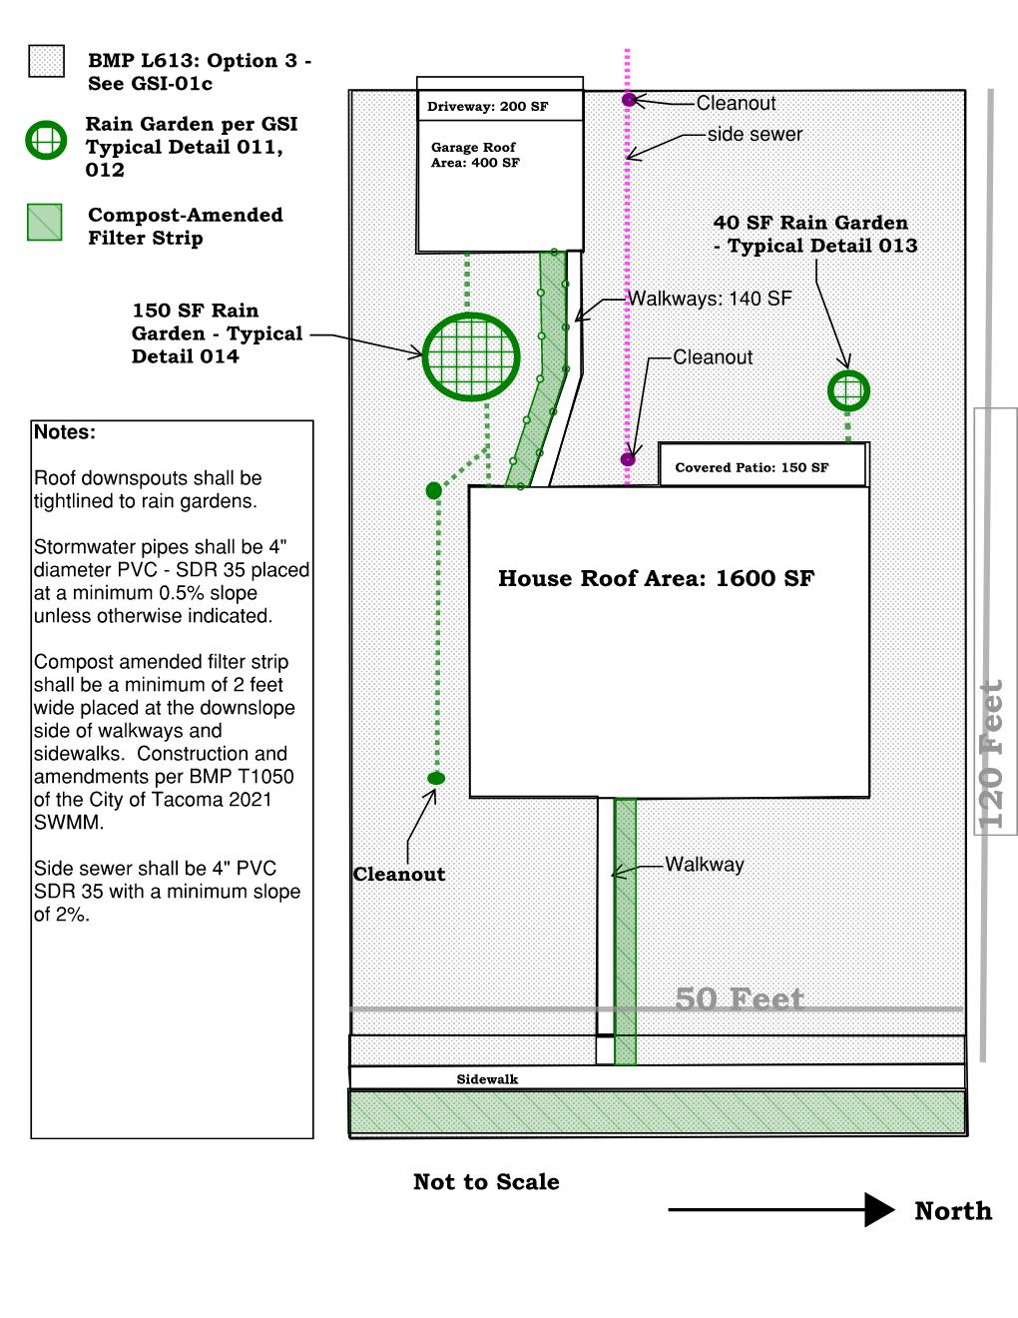
Example Project!

Slide 67
Questions? Please Use Q&A…and a joke!
How do you get rid of lazy tomato employees?
Can Them!!

Slide 68
Break 2!

Slide 69
Minimum Requirement Determination!!
Definitions
Flowcharts
Words in the SWMM
Proposed Project Conditions Map (Table)
Most Sensitive Receiving Waterbody

Slide 70
Quantifying the Project
Minimum Requirements are based upon the square footage of “impacts” to a project site.
There is no “net concept”. New hard surfaces are new hard surfaces and replaced hard surfaces are replaced hard surfaces – they both count toward thresholds.
Example – a school with a play field. An existing school that is being removed and a new school is being built on the old pervious field – where the old school was will be the new field. The buildings are the exact same size – this does not mean there are no requirements. The new school over the existing pervious play field is a new hard surface.

Slide 71
Minimum Requirement Thresholds
New Development – Site has Less than 35% Of Existing Hard Surface
Redevelopment - Site has 35% or more of Existing Hard Surface
Comply with Minimum Requirement #1-5 for the new and replaced hard surfaces and the land disturbed:
Results in 2,000 square feet, or greater, of new plus replaced hard surface area, or
Has land disturbing activity of 7,000 square feet or greater.

Slide 72
Which MRs Apply?

Slide 73
Survey #4 – Which MRs must be reviewed for this project?
Project Reminder:
Existing Conditions:
Total Project Area: 6,648 ft²
Total Onsite Lot Area: 6,000 ft²
Grassy Lot: 6,000 ft²
Total Offsite Area: 648 ft²
Grassy/Gravelly Area: 598 ft²
Front Road: 30 ft²
Back Alley: 20 ft²
Proposed Condition:
Onsite
New Single Family Home with Detached Garage
New House Roof Area: 1,200 ft²
Patio: 150 ft²
New Detached Garage Roof Area: 400 ft²
New Driveway: 180 ft²
Walkways: 140 ft²
Landscaped Areas: 3930 ft²
Offsite Improvements:
Sidewalk along Frontage: 184 ft²
Side Sewer Utility Cut: 30 ft²
Planter Strip and Back of Walk = Landscaped: 414 ft²
Driveway Approach: 20 ft²
Example Project!

Slide 74
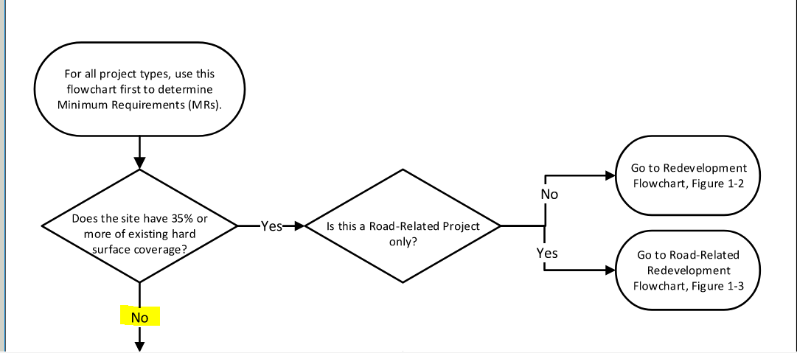
All Project Flowchart
Example Project!
Notes:
Remember the definition of a project here!

Slide 75
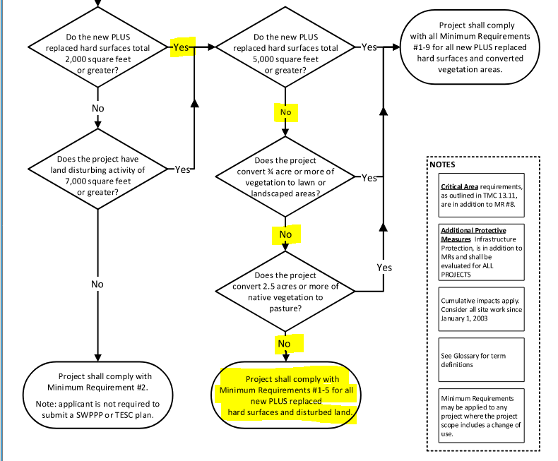
All Project Flowchart
Example Project!

Slide 76
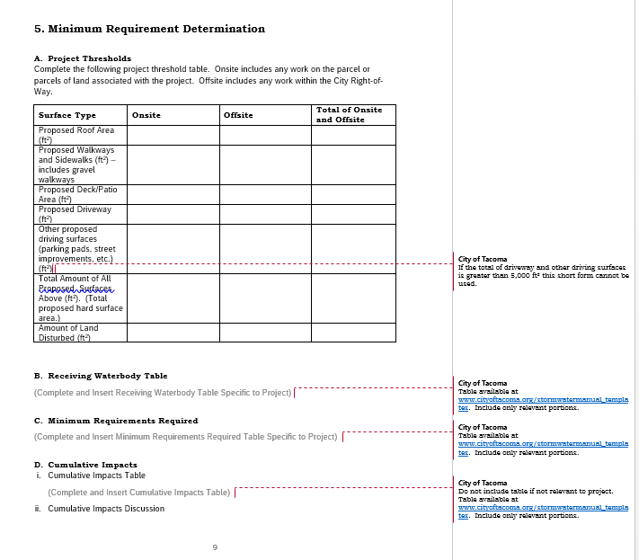
Minimum Requirement Determination Tables

Slide 77
Project Threshold Table
Example Project!
Surface Type (ft²) | Onsite | Offsite | Total of Onsite and Offsite
Proposed Roof Area | 1600 | 0 | 1600
Proposed Walkways and Sidewalks (including gravel walkways). | 140 | 184 | 324
Proposed Deck/Patio | 150 | 0 | 150
Proposed Driveway | 180 | 20 | 200
Other Proposed Driving Surfaces (parking pads, street improvements, etc.) | 0 | 30 (utility cut) | 30
Total Amount of All Proposed Surfaces Above (Total Hard Surface Area) | 2070 | 234 | 2304
Amount of Land Disturbed | 6000 | 648 | 6648
Notes:
Bring up table from website.

Slide 78
Cumulative Impacts Table
Used to determine how Minimum Requirements apply when construction has occurred on the site since 2003.
Must take into account all construction that has occurred on the site since 2003.
Example: Build Home in 2006. Build Garage in 2012 – that garage may be under the 2,000 SF threshold but would still have to comply with MRs.
Notes:
Bring up table from website.

Slide 79
Receiving Waterbody Table
How to determine the type of receiving waterbody?
tMap provides some basic information but also Ask Us! What is shown might not be up to date or might not be relevant to SWMM compliance.
Notes:
Bring up table from website.

Slide 80
Where is the Project?
Minimum Requirements (MR #5, MR#6, MR#7, MR#8) are based upon the most sensitive receiving waterbody encountered downstream from the project site.
A receiving waterbody – naturally and/or reconstructed naturally occurring surface water bodies, such as creeks, streams, rivers, lakes, wetlands, estuaries, and marine waters, or groundwater, to which a stormwater system discharges.
“Most sensitive for SWMM.”
Wetlands
Waterbodies that are Not Flow Control Exempt Waterbodies
Flow Control Exempt Waterbodies
Common mistake – not knowing every receiving waterbody which means not knowing which is most sensitive waterbody and not selecting the correct MRs.

Slide 81
Flow Control Exempt
A project is flow control exempt if stormwater from that project discharges directly or indirectly to saltwater bodies, or the Puyallup River and all the following restrictions are met:
Direct discharge to the saltwater body, or the Puyallup River does not result in the diversion of stormwater and surface water from certain streams and wetlands.
Flow splitters are appropriately designed for routing stormwater to certain stream and wetland types.
Stormwater and surface water from the project must discharge to a conveyance system that is comprised entirely of artificial conveyance elements (e.g., pipes, ditches, outfall protection) and extends to the ordinary high water line of the exempt receiving water.
The conveyance system between the project and the exempt receiving water shall have sufficient hydraulic capacity to convey discharges from future build-out conditions (under current zoning) from contributing areas of the Site, and the existing conditions from contributing off-site areas. (For MR determination (not Additional Protective Measure) assume this condition is always met).
Any erodible elements of the artificial conveyance system must be adequately stabilized to prevent erosion under the conditions noted above.

Slide 82
Flow Control Exempt – Small Project
Generally assumed if stormwater is not being routed to a separate basin as part of the project and the project discharges to saltwater bodies or the Puyallup River without first discharging into another waterbody it is flow control exempt.
This includes any discharges through the City of Tacoma stormwater system.
If from your site the stormwater goes into the City of Tacoma stormwater system it is still necessary to follow that stormwater all the way to the Puget Sound to see what waterbodies it is discharging to along the way.
Necessary for determining how Minimum Requirement #5 applies to project.

Slide 83
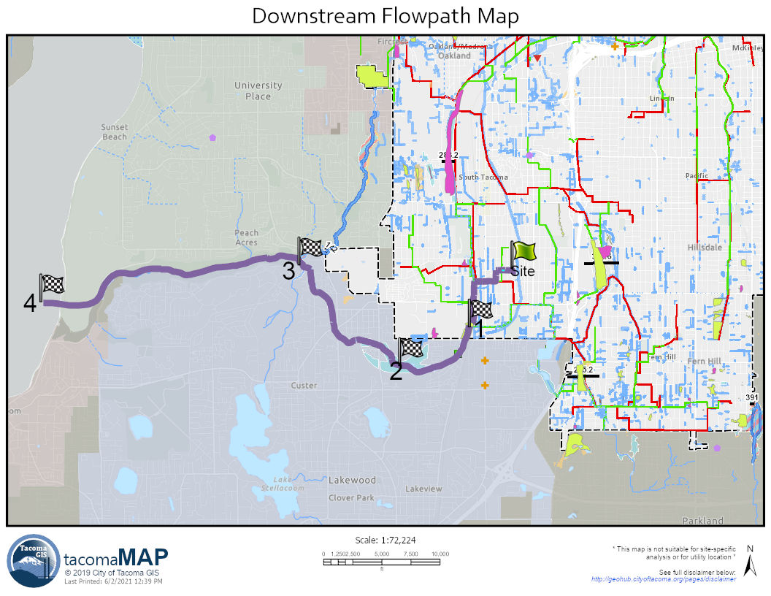
Survey #5 – Is our project flow control exempt?
Example Project!

Slide 84
Questions? Please Use Q&A…and a joke!
Why did the tomato blush?
Because it saw the salad dressing!!

Slide 85
Break

Slide 86
Minimum Requirement Discussion and Compliance
Minimum Requirement #1 – Preparation of a Stormwater Site Plan
Report and plan set that describe the existing project site conditions and present how stormwater will be managed for the proposed conditions.
Long Form and Short Form Template
Short Form for Projects that Trigger MR#1-5 Only.
We are currently using the short form for our project!

Slide 87
Minimum Requirement Discussion and Compliance
Minimum Requirement #2 – Construction Stormwater Pollution Prevention Plan
All projects are responsible to prevent erosion and discharge of sediment and other pollutants into receiving waters.
Projects that trigger MR#2 must complete a SWPPP Report and plan set.
SWPPP describes how stormwater will be managed during construction. 13 Elements that must be addressed.
Element #1: Preserve Vegetation and Mark Clearing Limits
Element #2: Establish Construction Access
Element #3: Control Flow Rates
Element #4: Install Sediment Controls
Element #5: Stabilize Soils
Element #6: Protect Slopes
Element #7: Protect Stormwater System Inlets
Element #8: Stabilize Channels and Outlets
Element #9: Control Pollutants
Element #10: Control Dewatering
Element #11: Maintain BMPs
Element #12: Manage the Project
Element #13: Protect Permanent Stormwater BMPs
Long Form Construction Stormwater Pollution Prevention Form Available.
Short Form Construction SWPPP is combined with Short Form SSP.

Slide 88
MR #2 – Common Misses
Not describing why an Element is not required.
Not providing BMPs that will be used to meet the element.
Describing BMPs in the report but not showing them on the plan set.
Use ECY template for Construction Stormwater General Permit but do not alter to remove sampling and monitoring.
CESCL is required but the listed person’s CESCL certification has expired.

Slide 89
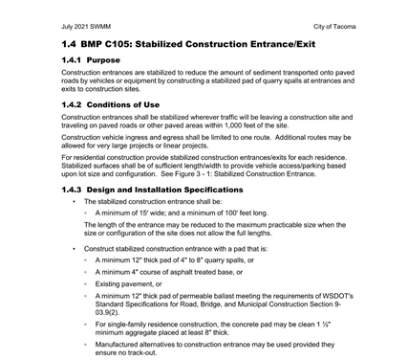
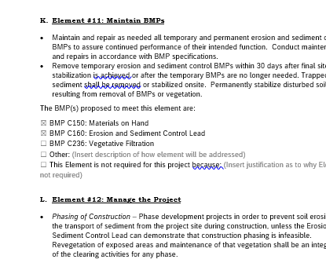
Our Project – MR#2

Slide 90
Minimum Requirement Discussion and Compliance
Minimum Requirement #3 – Source Control
All known, available and reasonable source control BMPs shall be applied to all projects. Source control BMPs shall be selected, designed, and maintained according to Volume 6 of this manual. Structural and operational source control BMPs shall be identified in the stormwater site plan report and structural source control BMPs shall be shown on construction plans submitted for City review.
BMPs for final site use intended to prevent stormwater from coming in contact with pollutants.
Spreadsheet to Help Pick Appropriate BMPs based on final site activity.
Common Mistake – including TESC BMPs in this section instead of under MR#2.

Slide 91
What Does MR #3 Look Like?
Single Family Home
Washing items only where water can drain to the wastewater system.
Using appropriate waste containers.
Using natural yard care practices.
Storing materials under cover.
Small Commercial
Sweeping
Covering Garbage Bins
Washing items only where water can drain to the wastewater system such as inside a building.
Notes:
A little time about industrial permit and demonstrative approach.

Slide 92
Our Project – MR#3

Slide 93
Minimum Requirement Discussion and Compliance
MR#4 – Preserving Drainage Patterns and Outfalls
For all projects, the natural and/or existing condition drainage patterns shall be maintained and discharges from the project site shall occur at the natural and/or existing discharge location to the maximum extent practicable.
Stormwater shall not cause adverse impacts to downgradient properties or to the receiving waters.
Can only discharge increased stormwater onto neighboring properties with their permission. (No open pipe discharges onto neighbors properties – if appropriate dispersion per SWMM has taken place and vegetated flowpaths are maintained that is typically okay).

Slide 94
Our Project – MR#4

Slide 95
Minimum Requirement Discussion and Compliance
MR#5 – Onsite Stormwater Management
Projects shall employ Stormwater Management BMPs to infiltrate, disperse, and retain stormwater onsite to the extent feasible without causing flooding or erosion impacts.
The List Approach or The LID Performance Standard
The List Approach only can be used when using Short Form SSP.

Slide 96
MR#5 – The List Approach
Analyze BMPs from a preset list for feasibility to use onsite. If the BMP is feasible it shall be used for that surface type. If BMPs are not feasible it may be possible to collect and convey to the City system.
Feasibility determined by evaluation against design criteria, limitations, and infeasibility criteria identified for each BMP and competing needs criteria.
BMPs must be analyzed in order presented in the table.
List #1: Projects that Trigger Only Minimum Requirement #1-5 – Not Flow Control Exempt
List #2: Project that Trigger Minimum Requirement #1-9 – Not Flow Control Exempt.
List #3: Flow Control Exempt Projects
Use Infeasibility Checklists to Analyze BMPs for feasibility.

Slide 97
Survey #6 – What List Should we Use for the List Approach?
Example Project!
Single Family Home – Project Reminder
Not Flow Control Exempt
Required to Comply with Minimum Requirements #1-5 and #9.

Slide 98
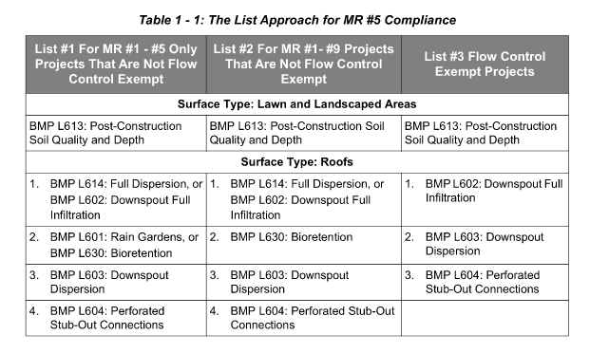
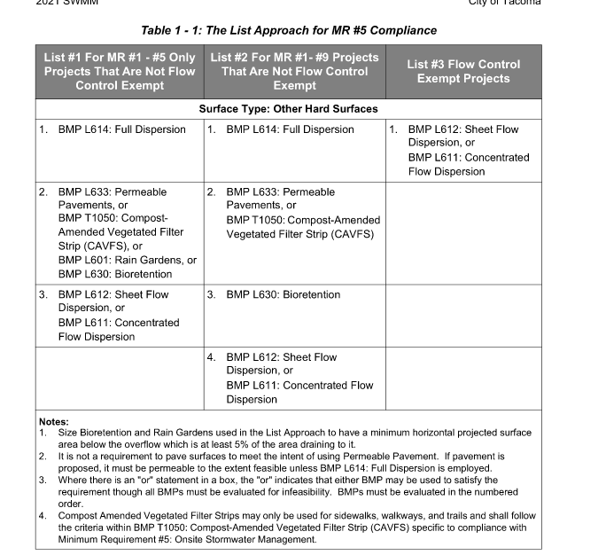

Slide 99
MR #5 – LID Performance Standard
The LID Performance Standard allows for the use of any BMPs sited throughout the project site that when modeled meet the LID Performance Standard. The LID Performance Standard allows for a more flexible site design. The LID Performance Standard requires modeling by a Washington State Licensed Professional Engineer. The modeling outputs shall be included in the Stormwater Site Plan Report. See Volume 2 - Documentation for additional information on what is required for modeling outputs.
Utilize one or a combination of Flow Control BMPs to meet the flow reduction modeling standards below. Rain Gardens cannot be used to achieve the LID Performance Standard though Bioretention may be used provided it is designed to provide flow control.
Cannot use the Short Form SSP with this option.

Slide 100
The List Approach Table
Surface Type: Roofs
Not Flow Control Exempt |  | Flow Control Exempt
Analyze Each BMP in the order listed below. Where there is more than one BMP listed, put a checkmark next to the one analyzed. If a BMP is feasible, that BMP must be used and it is not necessary to analyze other BMPs for feasibility. | Is BMP Feasible? | Analyze each BMP in the order listed below. If a BMP is feasible, that BMP must be used and it is not necessary to analyze other BMPs for feasibility. | Is BMP Feasible?
Choose One: ☐ BMP L614: Full Dispersion or ☐ BMP L602: Downspout Full Infiltration | ☐ Yes ☐ No | BMP L602: Downspout Full Infiltration | ☐ Yes ☐ No
Choose One: ☐ BMP L601: Rain Gardens or ☐ BMP L630: Bioretention | ☐ Yes ☐ No | BMP L603: Downspout Dispersion | ☐ Yes ☐ No
BMP L603: Downspout Dispersion | ☐ Yes ☐ No | BMP L604: Perforated Stub-Out Connections | ☐ Yes ☐ No
BMP L604: Perforated Stub-Out Connection | ☐ Yes ☐ No

Slide 101
The List Approach Table
Surface Type: Other Hard Surfaces
Not Flow Control Exempt |  | Flow Control Exempt
Analyze Each BMP in the order listed below. Where there is more than one BMP listed, put a checkmark next to the one analyzed. If a BMP is feasible, that BMP must be used and it is not necessary to analyze other BMPs for feasibility. | Is BMP Feasible? | Analyze Each BMP in the order listed below. Where there is more than one BMP listed, put a checkmark next to the one analyzed. If a BMP is feasible, that BMP must be used and it is not necessary to analyze other BMPs for feasibility. | Is BMP Feasible?
BMP L614: Full Dispersion | ☐ Yes ☐ No | Choose One: ☐ BMP L612: Sheet Flow Dispersion, or ☐ BMP L611: Concentrated Flow Dispersion | ☐ Yes ☐ No
Choose One: ☐ BMP L633: Permeable Pavement, or ☐ BMP T1050: Compost-Amended Vegetated Filter Strip (CAVFS), or ☐ BMP L601: Rain Gardens, or ☐ BMP L630: Bioretention | ☐ Yes ☐ No
Choose One: ☐ BMP L612: Sheet Flow Dispersion, or ☐ BMP L611: Concentrated Flow Dispersion | ☐ Yes ☐ No

Slide 102
The List Approach Table
Surface Type: Lawn/Landscaped Areas
Not Flow Control Exempt |  | Flow Control Exempt
Analyze the BMP below for feasibility. If the BMP is feasible if must be used. | Is BMP Feasible? | Analyze the BMP below for feasibility. If the BMP is feasible if must be used. | Is BMP Feasible?
BMP L613: Post-Construction Soil Quality and Depth | ☐ Yes ☐ No | BMP L613: Post-Construction Soil Quality and Depth | ☐ Yes ☐ No

Slide 103
What to Submit – MR#5
If using the List Approach:
Fill out Table in SSP.
Include the infeasibility checklist for any BMPs deemed infeasible.
Include a reference to associated documents used for determining infeasibility such as Soils Report, survey showing project site topography, maps showing distance to property lines, etc.
Provide sizing calculations for all BMPs proposed.
Infeasibility checklists are available at www.cityoftacoma.org/stormwatermanual_templates. Include only the infeasibility checklists necessary for the project.
Facility sizing sheets can be found at www.cityoftacoma.org/stormwatermanual_templates.

Slide 104
MR #5 – Infeasibility Checklists
No need to answer all questions. Unless otherwise noted, a single answer of No means the BMP is infeasible.
Certain criteria require specific expertise like P.E. or soils report.

Slide 105
MR #5 – List Approach Sizing Sheets
Notes:
Cannot be used alone for the LID Performance Standard. Must also have continuous simulation modeling.

Slide 106
MR#5 – Common Mistakes
Not using infeasibility criteria contained within the SWMM.
Just stating infiltration is not feasible. This is not an infeasibility criteria.
Not including supporting materials for infeasibility such as soils report, setback information, etc.
Sizing information not included for feasible BMPs.
Not including full WWHM report to substantiate LID Performance Standard.

Slide 107
Questions? Please Use Q&A…and a joke!
What looks like a half tomato?
The other half!!

Slide 108
MR #6 – Stormwater Treatment
If this statement is false – the Stormwater Site Plan Short Form cannot be used and applicant must review Minimum Requirement #6 to see if stormwater treatment is required and the Stormwater Site Plan Long Form must be used.

Slide 109
MR #7 – Flow Control
If this statement is false – the Stormwater Site Plan Short Form cannot be used and applicant must review Minimum Requirement #7 to see if flow control is required and the Stormwater Site Plan Long Form must be used.

Slide 110
MR #8 – Wetlands Protection
If this statement is false – the Stormwater Site Plan Short Form cannot be used and applicant must review Minimum Requirement #8 to see if wetlands protection is required and the Stormwater Site Plan Long Form must be used.

Slide 111
MR #9 – Operation and Maintenance
Requires an Operation and Maintenance Manual for all proposed permanent stormwater BMPs.
Stand-alone document (submit separately – do not attach to SSP/SWPPP). Template available!
Must identify party responsible for maintenance.
Copy must be kept onsite or within reasonable access to site.
O&M must be transferable to new property owner.
Covenant and Easement (C&E) Agreements
A legal means to ensure maintenance is performed on private properties.
Allows City access to the facilities for inspection
Recorded to title.
Required for all proposed permanent stormwater BMPs.

Slide 112
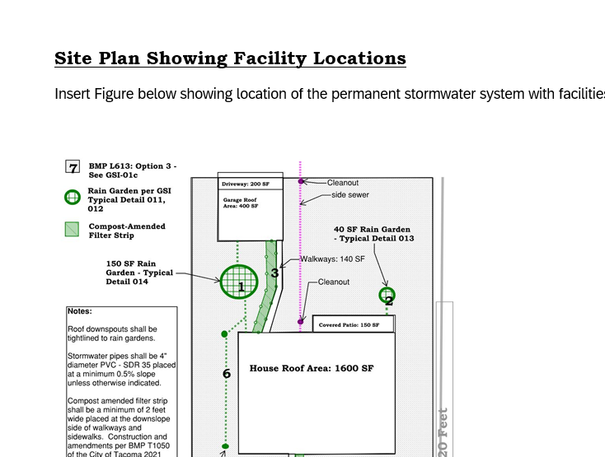
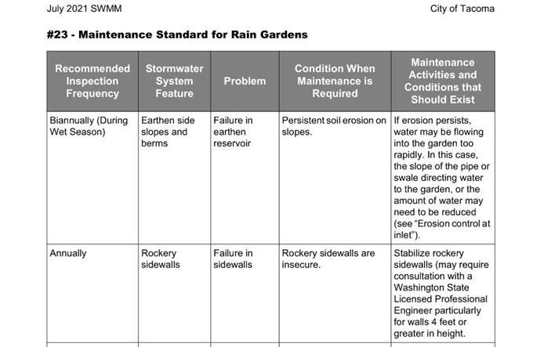
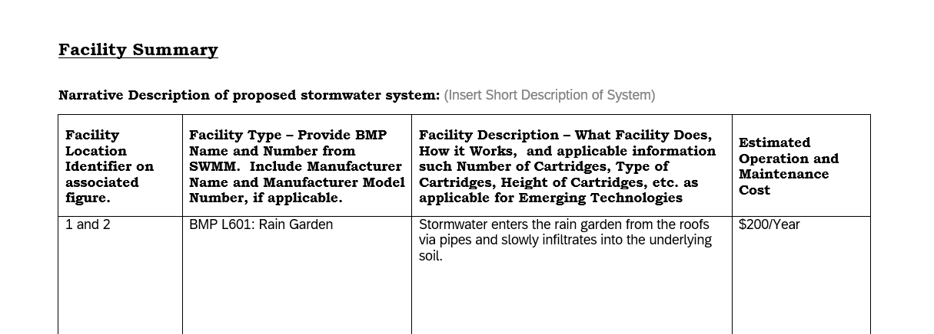
Our Project – O&M

Slide 113
MR #9 – Common Misses
Figure showing facility location not included.
Figure does not obviously show where facilities are located.
Contact information for person responsible for maintenance not included.
Covenant and Easement Agreement not complete.

Slide 114
Questions? Please Use Q&A…and a joke!
What type of tomato smells best?
A Roma!!

Slide 115
Home Stretch Break!!!
Notes:
Play Final Countdown - Styx

Slide 116
Additional Protective Measure – Infrastructure Protection
Projects that impact the downstream system by increasing the amount of stormwater to the downstream private or public stormwater system may be required to complete a quantitative downstream analysis of the downstream system to ensure the system is appropriately sized before a connection to the system will be allowed.
Typically not required for smaller projects.

Slide 117
Can I Just Discharge Directly to Curb Line?
Only allowed if MR #5 BMPs are not feasible and cannot be used to fully infiltrate or disperse stormwater onsite.
Curb line (asphalt wedge or curb and gutter) must be present.
Conveyance to the curb will only be allowed if:
A catch basin or other inlet to the conveyance system is located within 350 feet downstream of the discharge location.
Stormwater discharges from the project site remain in the gutter line to the nearest stormwater system inlet. Existing or new curb shall be tall enough to ensure water remains in the gutter line.
Stormwater discharges from the project site enter a stormwater system inlet before the next downstream intersection.
Stormwater discharges are not on the high side of full warp street section.
If above conditions cannot be met, extension of the stormwater system is required.

Slide 118
Conveyance System Design
Small Project typically will not be required to model the onsite conveyance system.
Minimum pipe sizes for roofs shall be 3”.
Minimum pipe sizes for driveways shall be 6”.

Slide 119
Construction Stormwater Pollution Prevention Plan
Report is part of Combined SSP/SWPPP.
Must describe BMPs that will be used to meet all 13 Elements.
If an Element is not needed – must describe why it is not needed.
Plan set must show location of BMPs.
Must include BMPs from SWMM that will be used. Word documents of each BMP are available at www.cityoftacoma.org/stormwatermanual_templates for easy copy and paste.

Slide 120
Additional Documentation
Temporary Erosion and Sediment Control BMPs
Must attached BMPs (only those proposed to be used) from the SWMM in entirety. Various formats available at www.cityoftacoma.org/stormwatermanual_templates to aid in doing this.
Soils Report –Separate Stand-Alone Document
Common mistake: soils report do not match BMP design and do not include appropriate information for MR # infeasibility.
Common mistake: soils logs are not taken at appropriate depths.
Operation and Maintenance Manual
Separate stand-alone document.
Plan Set
Site Plan
Building plans.

Slide 121
Other Commonly Missed Items - General
Not packaging material appropriately. 10-20 different documents that should have all been included in SSP.
Plan sets do not match report.
Plan sets not accurate or do not include complete information
Not to Scale
Pipe slopes
Inverts
Rim Elevations
Facility Dimensions
Utility Conflicts
No details or details do not match other plan sets.

Slide 122
Questions? Please Use Q&A…and final words of wisdom!
Knowledge is knowing a tomato is a fruit.
Wisdom is not putting it in a fruit salad.

Slide 123
Post Zoom Survey
You should receive a survey after this webinar ends. Please fill out to let us know how we are doing and if you have any ideas for future trainings, etc.

Slide 124
Wrap Up
Thanks for attending this training
We hope it is helpful to you now and in future
Slide deck and recording will be available at www.cityoftacoma.org/stormwatermanual
Hopefully by end of the month.
Contact us if you have specific questions:
Mieke Hoppin – mhoppin@cityoftacoma.org
Craig Kuntz – ckuntz@cityoftacoma.org
Brenda Reifsnyder – breifsnyder@cityoftacoma.org
Chris Johnson – cjohnso2@cityoftacoma.org
Site Development (Stormwater)– 253-591-5030 or email sitedevelopment@cityoftacoma.org

